Slide 1
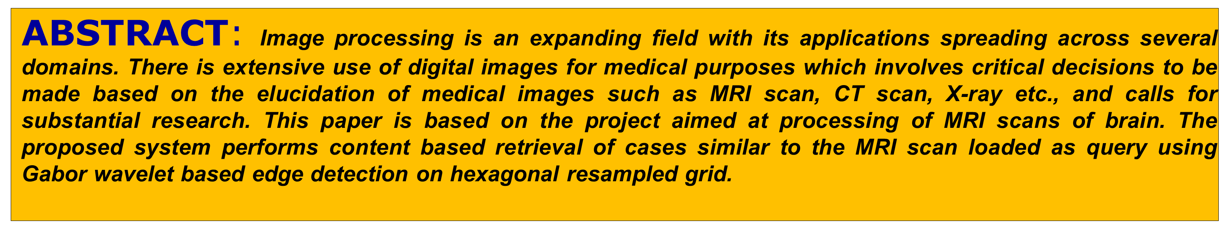
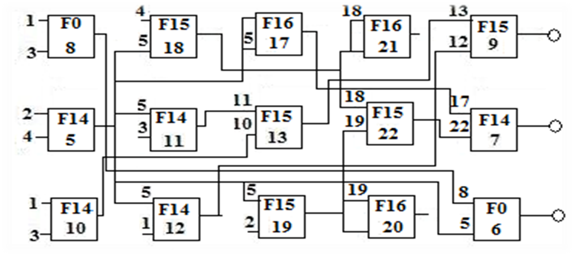
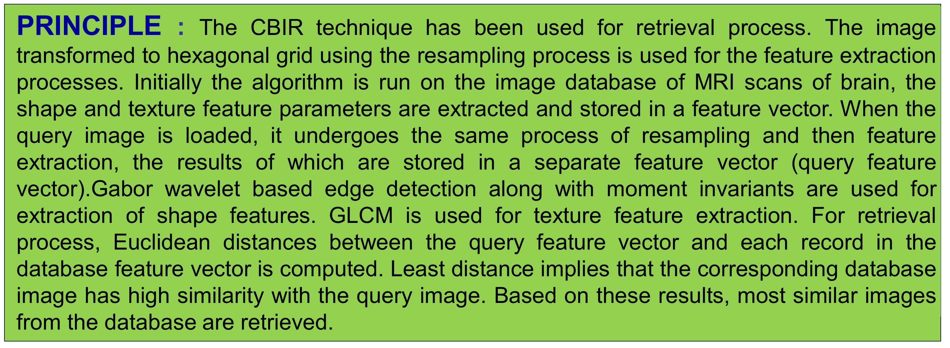
A Novel Approach to evolve 2 bit adder
*Dattprasad B. Vernekar, **Gayatri. Malhotra, *Vanessa Colaco
*Department of Electronics of Telecommunication, Goa Engineering College, Goa - 403401, *Control System Group, ISAC Bangalore – 560017 dattprasad@gmail.com, gayatri@isac.gov.in, vanessa@gec.ac.in
Input Output
Function | Function No | Logic Function
F0 | 0 | XOR
F1 | 14 | AND
F2 | 15 | OR
F3 | 16 | NOT
F={F₀, F₁, F₂, F₃}; n_{c}=5; n_{r}=3; n_{i}=6; n_{o}=3; n_{n}=2; n_{f}=4. Genotype: 1, 3, 0; 4, 5, 15; 5, 5, 16; 18, 18, 16;13, 12, 15; 2, 4, 14; 5, 3, 14; 11, 10, 15; 19, 18, 15; 17, 22, 14; 1, 3, 14; 5, 1, 14; 5, 2, 15; 19, 19, 16; 8, 5, 0; 9; 7; 6.
Last three integer determine output
Cartesian Genetic Programming:
Parameters : (Input₁,…., Input, Function)
Function: F[F₁,…., F_{N}]
Rows, Columns, Inputs, Outputs, Inputs to each function, Number of Functions
Every node has third gene as Function
Inputs to the first column forms the primary input to adder,
Second and higher column gets input from previous column.
For the above 2 bit configuration as each gene is coded by 5 bits, the length of
genotype, phenotype is 225 bits.
2 bit adder
Primary inputs : 1, 2, 3, 4
Logic Functions : 0, 14, 15, 16
Evolved Outputs : 7, 6, 9
Represent individual gene by bit string of 5 bits each :
Input cases | MSB | LSB
1 | 0 | 0
2 | 0 | 1
3 | 1 | 0
4 | 1 | 1
Gene Binary code Gene Binary code Before Crossover:
Analogy of Biology and GA : Primary Inputs to 2 bit adder : Reference Table :
Input₁ Input₂ Output
Working Principle of GA:
Start
Initial Population
First Generation
Evaluate Fitness
Condition Met
If Yes, terminate, Else
Proceed
7. Genetic Operators
8. Next Generation
9. Go to step 4
Biological terms | Genetic Algorithm
Chromosome | String | Divided into genes
Gene | Character | Code for changing character
Allele | Feature value | Possible gene for a property
Locus | String position | Position for a gene on chromosome
Genotype | Structure | Combination of gene
Phenotype | Alternative solution | Develops from genotype
0 | 0 | 0 | 0 | 0 | 0 | 16 | 1 | 0 | 0 | 0 | 0
1 | 0 | 0 | 0 | 0 | 1 | 17 | 1 | 0 | 0 | 0 | 1
2 | 0 | 0 | 0 | 1 | 0 | 18 | 1 | 0 | 0 | 1 | 0
3 | 0 | 0 | 0 | 1 | 1 | 19 | 1 | 0 | 0 | 1 | 1
4 | 0 | 0 | 1 | 0 | 0 | 20 | 1 | 0 | 1 | 0 | 0
5 | 0 | 0 | 1 | 0 | 1 | 21 | 1 | 0 | 1 | 0 | 1
6 | 0 | 0 | 1 | 1 | 0 | 22 | 1 | 0 | 1 | 1 | 0
7 | 0 | 0 | 1 | 1 | 1 | 23 | 1 | 0 | 1 | 1 | 1
8 | 0 | 1 | 0 | 0 | 0 | 24 | 1 | 1 | 0 | 0 | 0
9 | 0 | 1 | 0 | 0 | 1 | 25 | 1 | 1 | 0 | 0 | 1
10 | 0 | 1 | 0 | 1 | 0 | 26 | 1 | 1 | 0 | 1 | 0
11 | 0 | 1 | 0 | 1 | 1 | 27 | 1 | 1 | 0 | 1 | 1
12 | 0 | 1 | 1 | 0 | 0 | 28 | 1 | 1 | 1 | 0 | 0
13 | 0 | 1 | 1 | 0 | 1 | 29 | 1 | 1 | 1 | 0 | 1
14 | 0 | 1 | 1 | 1 | 0 | 30 | 1 | 1 | 1 | 1 | 0
15 | 0 | 1 | 1 | 1 | 1 | 31 | 1 | 1 | 1 | 1 | 1
Bit string 1 Bit string 2
Reconfigurable
Hardware
(Virtex E)
Applications:
Combinational circuits can be evolved using Evolvable Hardware
techniques, increasing the functionality of deployed hardware
systems for space missions.
Use of multichip system reduces the time required to redesign the
system every time.
The proposed evolvable unit can be redesigned according to the
needs of given application.
 | a(1) | a(0) | b(1) | b(0) | o(2) | o(1) | o(0)
0 | 0 | 0 | 0 | 0 | 0 | 0 | 0
1 | 0 | 0 | 0 | 1 | 0 | 0 | 1
2 | 0 | 0 | 1 | 0 | 0 | 1 | 0
3 | 0 | 0 | 1 | 1 | 0 | 1 | 1
4 | 0 | 1 | 0 | 0 | 0 | 0 | 1
5 | 0 | 1 | 0 | 1 | 0 | 1 | 0
6 | 0 | 1 | 1 | 0 | 0 | 1 | 1
7 | 0 | 1 | 1 | 1 | 1 | 0 | 0
8 | 1 | 0 | 0 | 0 | 0 | 1 | 0
9 | 1 | 0 | 0 | 1 | 0 | 1 | 1
10 | 1 | 0 | 1 | 0 | 1 | 0 | 0
11 | 1 | 0 | 1 | 1 | 1 | 0 | 1
12 | 1 | 1 | 0 | 0 | 0 | 1 | 1
13 | 1 | 1 | 0 | 1 | 1 | 0 | 0
14 | 1 | 1 | 1 | 0 | 1 | 0 | 1
15 | 1 | 1 | 1 | 1 | 1 | 1 | 0
Evolution Strategy
( Spartan II)
Reconfiguration
bits
Reconfiguration
bits
0 | 1 | 1 | 1
0 | 1 | 0 | 0
Fitness value
Fitness Value
FPGA based Run Time Configuration System
FPGA based EHW development and Evolution unit s et-up can be applied for future space applications
0 | 1 | 1 | 0
0 | 1 | 0 | 1
Bit string 1 Bit string 2
After Crossover
Mutation
CONCLUSION : This study proposed a model for Content Based Image Retrieval by using shape and texture features of the images. Shape features are extracted from the hexagonal resampled image, which gives improved edge detection. Final feature vector table contains both shape and texture features, resulting in improved retrieval. The system has been developed successfully in an efficient manner to achieve the expected output. The system is designed with flexible and consistent flow for easy understanding.
0 | 1 | 1 | 1 | 0 | 1 | 0 | 1
Primary Inputs
User Outputs
Functions
Intermediate Input Output
Unused Integer
Coding a gene by a binary string
0 | 1 | 1 | 0 | 0 | 1 | 0 | 1

